Slide 1
Query Processing
Jae Woo Joo

Slide 2
Contents
Scans
Update Scans
Implementing Scans
Pipelined Query Processing
The Cost of a Scan
Plans
Predicates

Slide 3
Contents
Scans
Update Scans
Implementing Scans
Pipelined Query Processing
The Cost of a Scan
Plans
Predicates

Slide 4
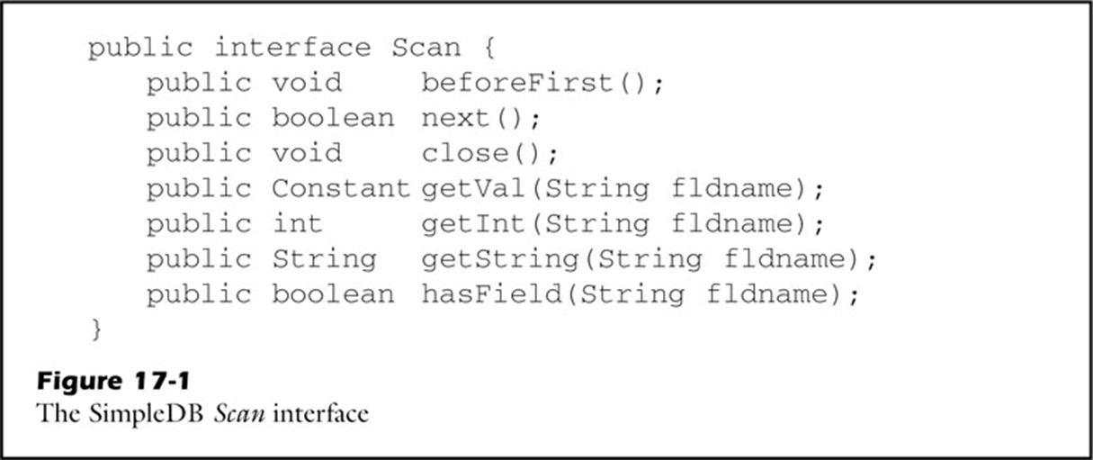
Scans
Scan
An object that represents a relational algebra query
Manages the execution of the query
Through underlying record files
Comparing values
Returns an object of type Constant

Slide 5
Scans
Difference between Scan & RecordFile
Scan
Read only
Does not need to know the entire schema
Have method getVal, getInt, and getString
RecordFile
Has both read and modify the file
Needs to know the entire schema
Have method getInt and getString

Slide 6
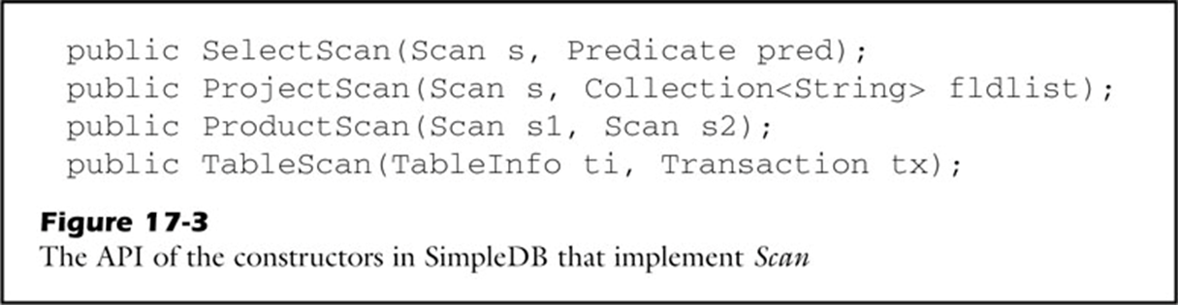
Scans
Each Scan object corresponds to a node in a query tree
Underlying scan
Denotes the input table to the select operator
Underlying scan

Slide 7
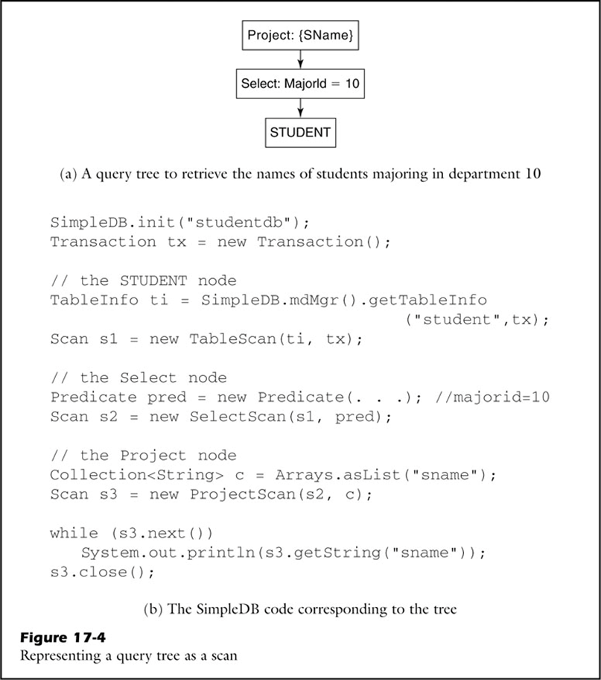
Scans
s3
s2
How query trees are built using scans
Ex) The names of the students majoring in department 10
s1
Close method should be called only on the outermost scan of a query tree

Slide 8
Contents
Scans
Update Scans
Implementing Scans
Pipelined Query Processing
The Cost of a Scan
Plans
Predicates

Slide 9
Update Scans
Updates are meaningful only for tables defined by certain kinds of queries
Scan is updatable if every record r in the scan has a corresponding record r’ in some underlying database table
Single-table: updatable, since each record of the view corresponds to a record from that table
Multi-table: not updatable, since the virtual view record is composed from at least two stored records

Slide 10
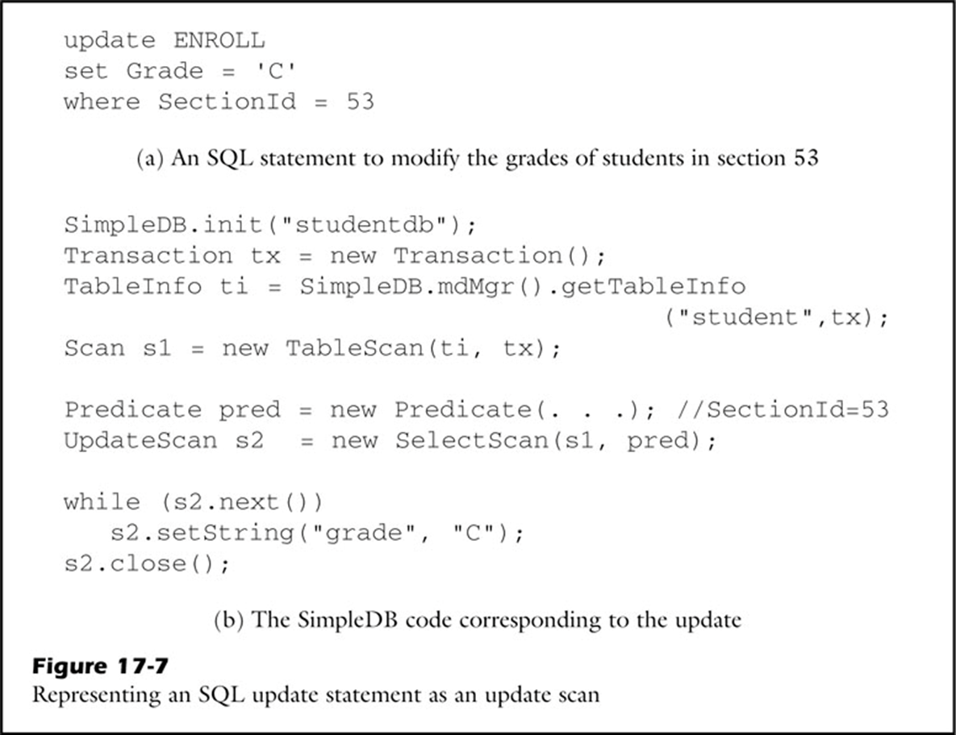
Update Scans
SimpleDB that implement UpdateScan
TableScan and SelectScan
Must be declared as an update scan -> setString

Slide 11
Contents
Scans
Update Scans
Implementing Scans
Pipelined Query Processing
The Cost of a Scan
Plans
Predicates

Slide 12
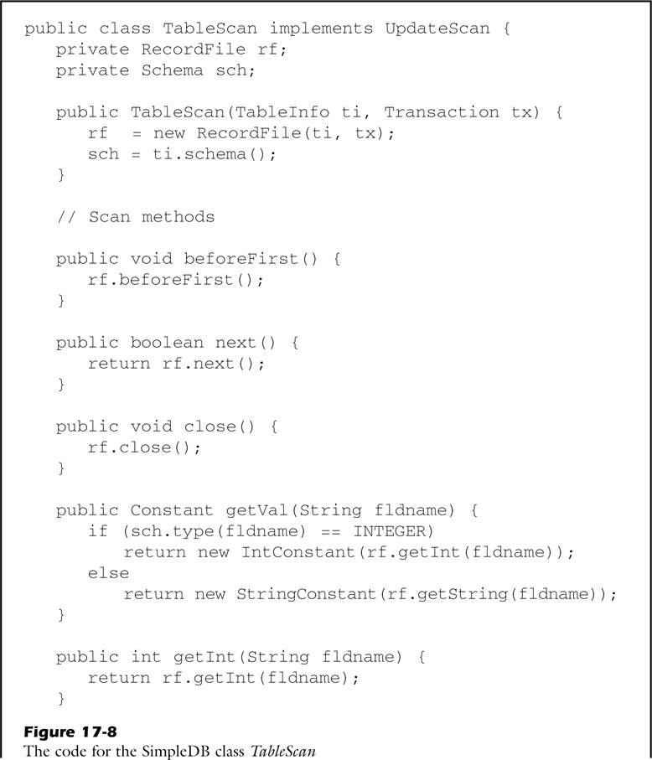
Implementing Scans
Table Scans
Table scans are updatable
Creates the appropriate constant based on the type of the field

Slide 13
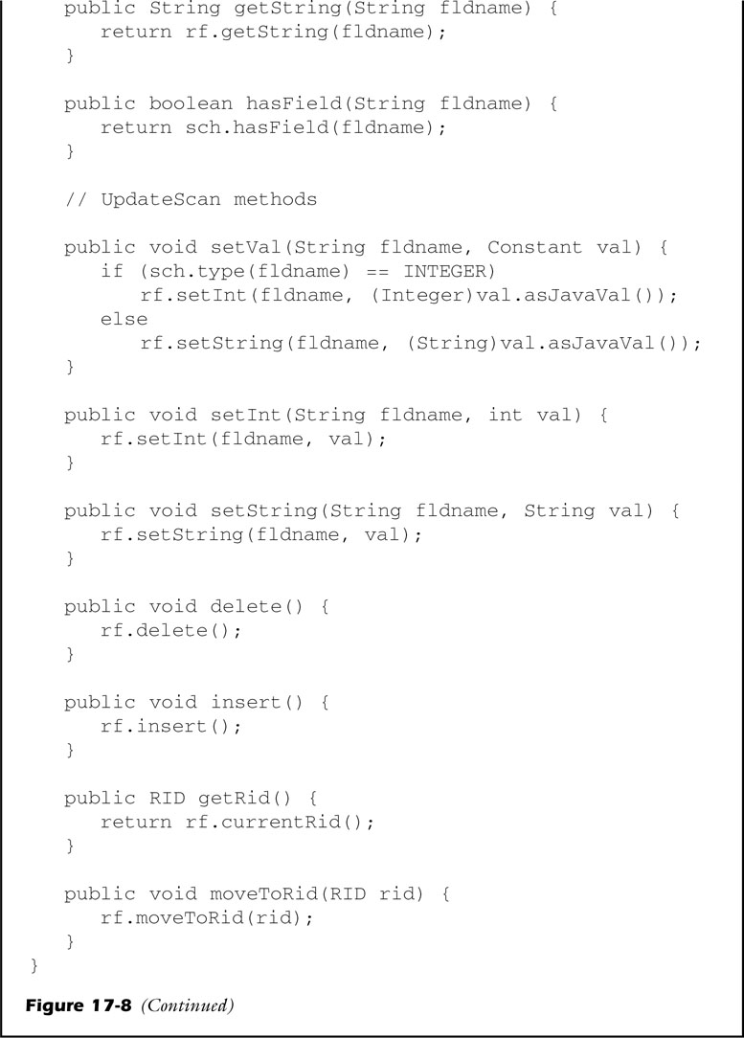
Implementing Scans
Table Scans
Table scans are updatable
Checks the table’s schema
Extracts the value from the constant and sends it to the record file

Slide 14
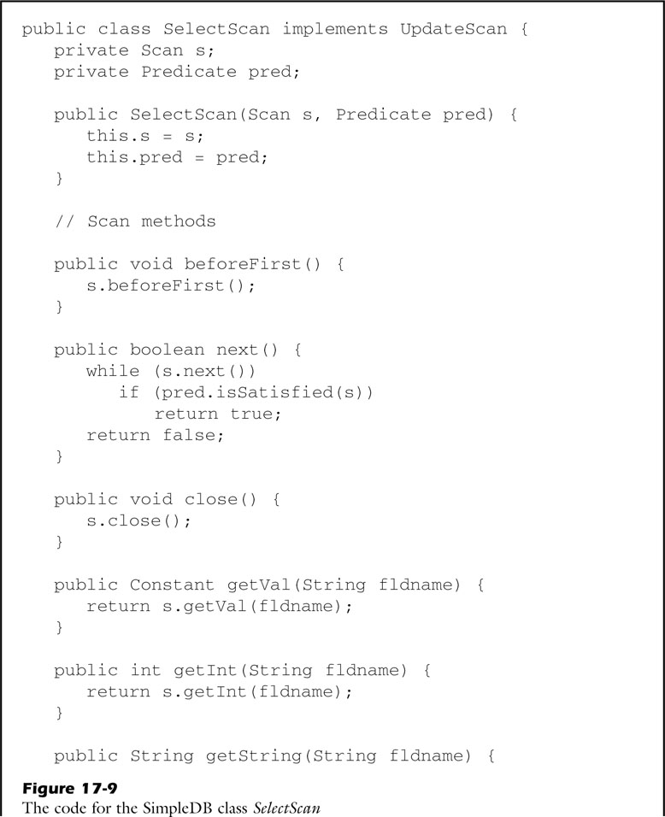
Implementing Scans
Select Scans
The current record of the scan is the same as the current record of its underlying scan
Select scans are updatable
Establish a new current record

Slide 15
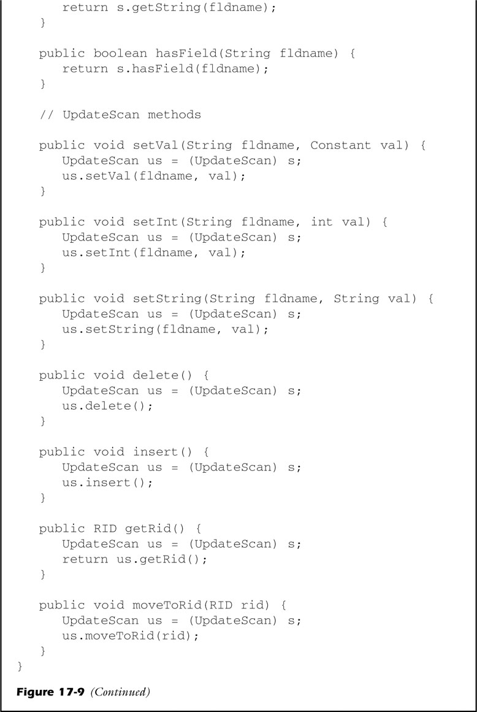
Implementing Scans
Select Scans
Select scans are updatable

Slide 16
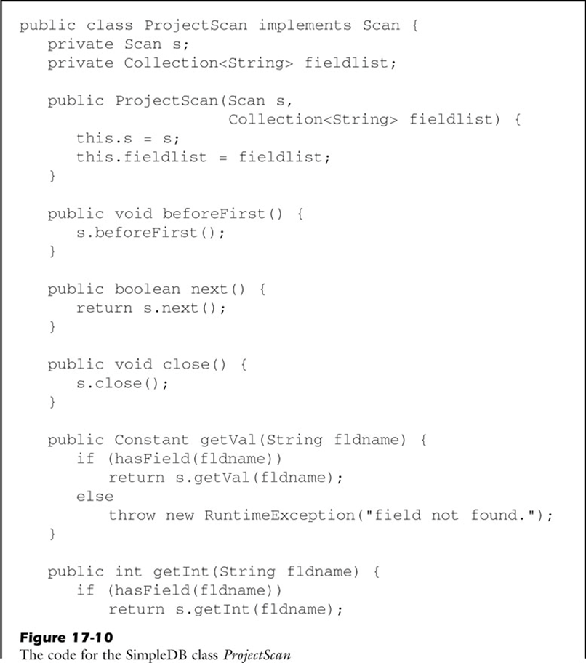
Implementing Scans
Project Scans
Projections are updatable
Does not implement UpdateScan
It checks whether the specified field name is in the field list

Slide 17
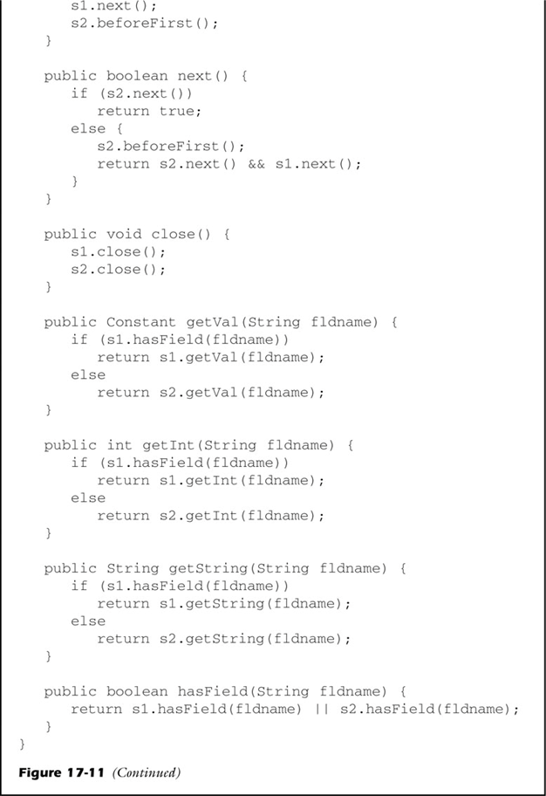
Implementing Scans
Product Scans
Needs to iterate through all possible combinations of records
Like having a nested loop with the outer loop s1 and the inner loop s2
Implements as a nested loop

Slide 18
Contents
Scans
Update Scans
Implementing Scans
Pipelined Query Processing
The Cost of a Scan
Plans
Predicates

Slide 19
Pipelined Query Processing
Pipelined implementations
Generate their output records one at a time
Do not save their output records, and intermediate computation
Pipelined
Flow of the method calls down the query tree, and the flow of result values back up the tree

Slide 20
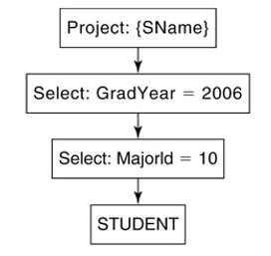
Pipelined Query Processing
Project node
Call next on its child node and returns the value of the node
Doesn’t change the number of block access
Select node
Inner node: MajorId = 10
Outer node: GradYear = 2006

Slide 21
Pipelined Query Processing
SName | GradYear | MajorId
A | 2005 | 10
B | 2006 | 11
C | 2006 | 10
D | 2007 | 12
True

Slide 22
Pipelined Query Processing
SName | GradYear | MajorId
A | 2005 | 10
B | 2006 | 11
C | 2006 | 10
D | 2007 | 12
True

Slide 23
Pipelined Query Processing
The record file comes to the end of the STUDENT table => return false
STUDENT table is scanned only once
= table scan
SName | GradYear | MajorId
A | 2005 | 10
B | 2006 | 11
C | 2006 | 10
D | 2007 | 12
False

Slide 24
Contents
Scans
Update Scans
Implementing Scans
Pipelined Query Processing
The Cost of a Scan
Plans
Predicates

Slide 25
The Cost of a Scan
Construct the most cost-effective scan for the given query
Number of block accesses is the most important factor in determining running time
S: scan, F: field in the schema of s
B(s) = number of the block accesses
R(s) = number of records in the output of s
V(s, F) = number of different F-values in the output of s

Slide 26
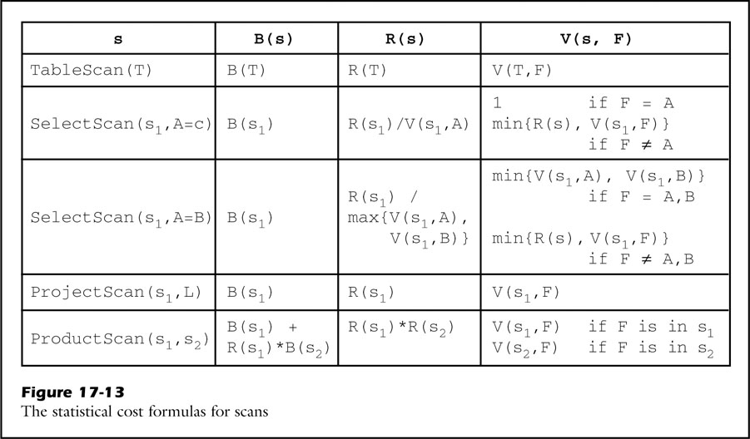
The Cost of a scan

Slide 27
The Cost of a scan
Table Scan
Table scan -> record file -> record page -> buffer -> page
When the records in that page have been read, its buffer is unpinned and the next page in the file takes its place
A single pass through the table scan -> access each block exactly once

Slide 28
The Cost of a Scan
Select Scan
S1: single underlying scan
Method next will cause the select scan to call s1.next
Select scan = same number of block accesses as its underlying scan
B(s) = B(s1)
R(s) and V(s, F) depends on the selection predicate

Slide 29
The Cost of a Scan
Select Scan
Selection on a Constant (A = c)
R(s) = R(s1) / V(s1, A)
V(s, A) = 1
V(s, F) = min{R(s), V(s1, F)} for all other fields F
Selection on a Field (A = B)
Assume V(s1, A) < V(s1, B)
R(s) = R(s1) / max{V(s1, A), V(s1, B)}
V(s, F) = min{V(s1, A), V(s1, B)} for F = A or B
V(s, F) = min{R(s), V(s1, F)} for all other fields F
Number of distinct value

Slide 30
The Cost of a Scan
Project Scan
Has a single underlying scan and requires no additional block accesses beyond its underlying scan
Does not change the number and value of records

Slide 31
The Cost of a Scan
Product Scan
Two underlying scans s1 and s2
New ProductScan(s1, s2)
New ProductScan(s2, s1)
RPB(s) = R(s) / B(s)
B(s) = B(s1) + RPB(s1) * B(s1) * B(s2)
Could be different number of block accesses
Depends the number of block accesses

Slide 32
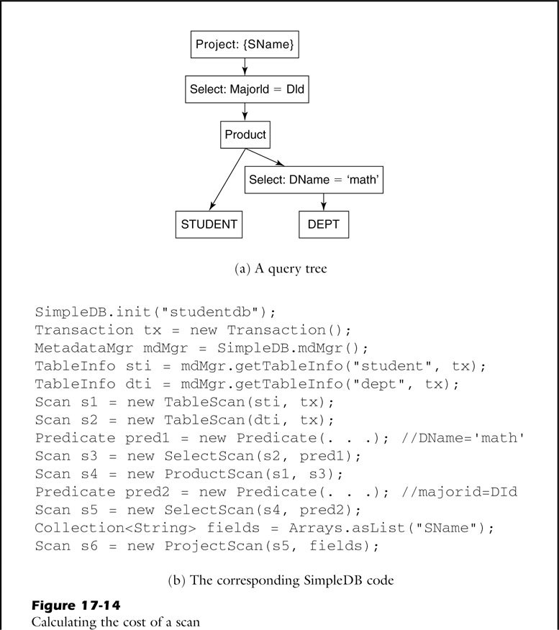
The Cost of a Scan
s6
s5
The query that returns the names of those students majoring in math
s4
s3
s1
s2

Slide 33
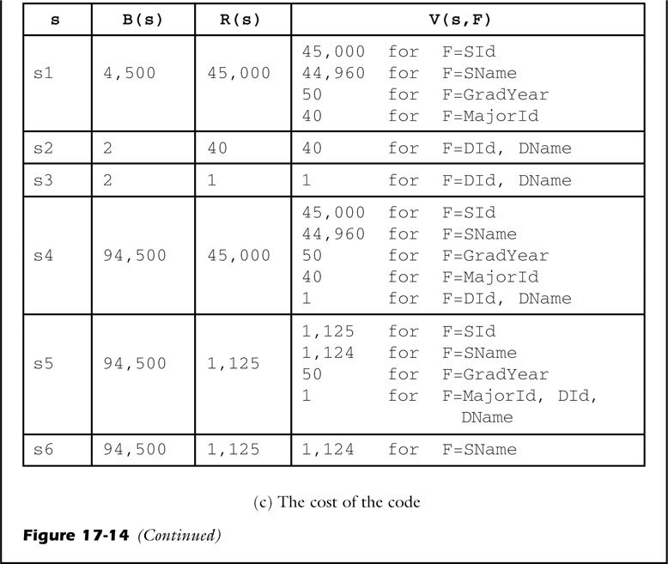
The Cost of a Scan
S1: the statistics for student
S2: the statistics for dept
S3: selection of Dname=‘math’
S4: Product between s1 &s3
S5: Selection of MajorId=Did
S6: Projection of SName

Slide 34
The Cost of a Scan
S4 returns all combinations of 45000 students with 1 selected record
B(s4) = B(s1)+R(s1)*B(s3)
R(s5) = R(s4)/V(s2, F)
RPB(s1) = 10, RPB(s3) = 0.5
If s4=new Product Scan(s3, s1)
B(s4)=B(s1)+RPB(s3)*B(s3)*B(s1)
=2 + 0.5 * 2 * 4500
=4502 (block accesses)
=> Could be more efficient!

Slide 35
Contents
Scans
Update Scans
Implementing Scans
Pipelined Query Processing
The Cost of a Scan
Plans
Predicates

Slide 36
Plans
An SQL query may have several equivalent query trees, with each tree corresponding to a different scan
Plan: A query tree constructed for the purpose of cost comparison
Planner should create a scan only the tree having the lowest cost

Slide 37
Plans
Difference between plan and scan
Plan
Has methods for estimating costs
Accesses the database’s metadata
Scan
Accesses the database
Record file will be opened for the query and then read the first block of its file into a buffer

Slide 38
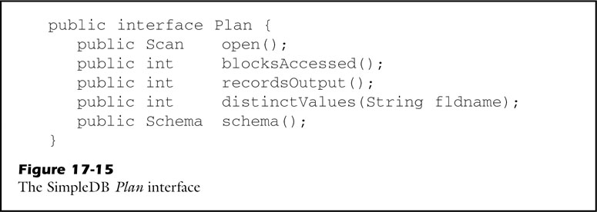
Plans
Open(): Creates its corresponding scan
blocksAccessed(): Calculates B(s)
recordsOutput(): Calculates R(s)
distinctValues() : Calculates V(s, F)

Slide 39
Contents
Scans
Update Scans
Implementing Scans
Pipelined Query Processing
The Cost of a Scan
Plans
Predicates

Slide 40
Predicates
Expression: Consists of operations on constant and field names
Term: Comparison between two expressions
Predicate: Boolean combination of terms
(GradYear=2006 or GradYear=2007) and MajorID=DId
Term

Slide 41
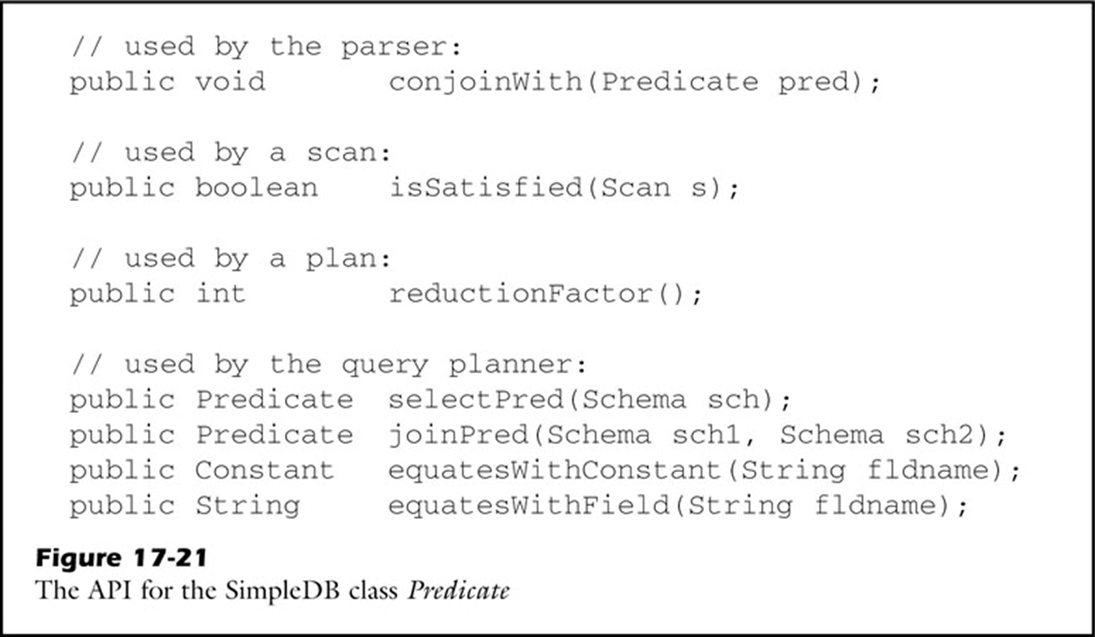
Predicates
To conjoin another predicate
Select scan evaluates a predicate
Select plan estimates a selectivity of a predicate

Slide 42
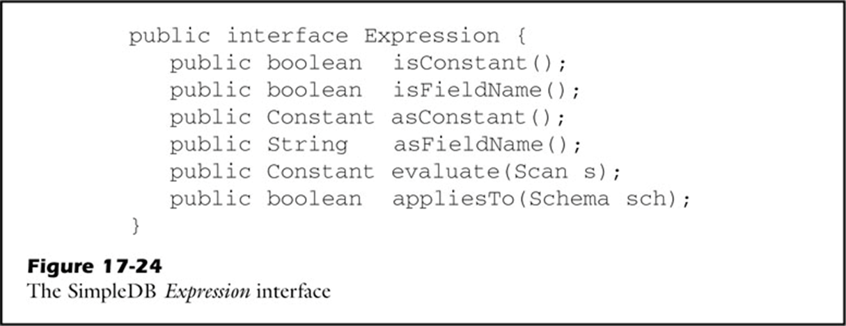
Predicates
Used during query evaluation, and returns the value of the expression

Slide 43
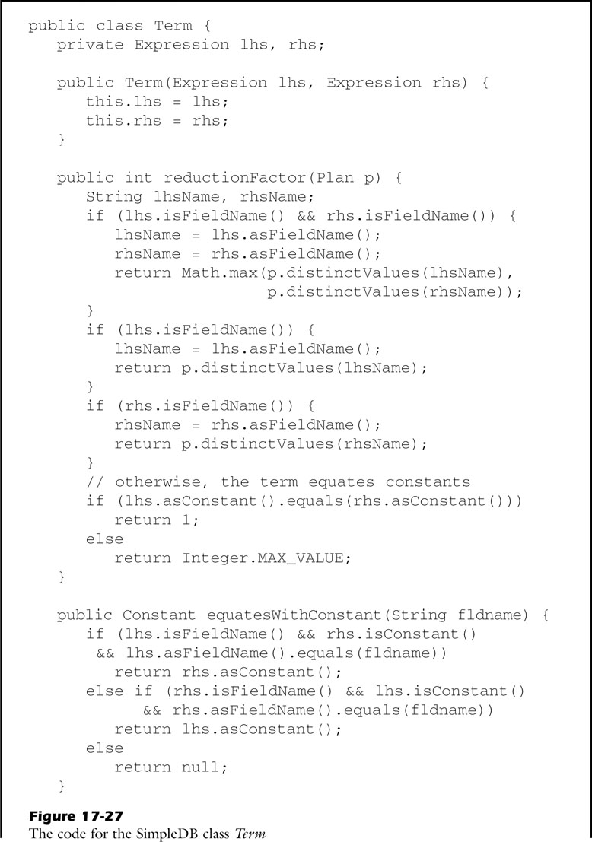
Predicates
reductionFactor
Encodes the selection formulas

Slide 44
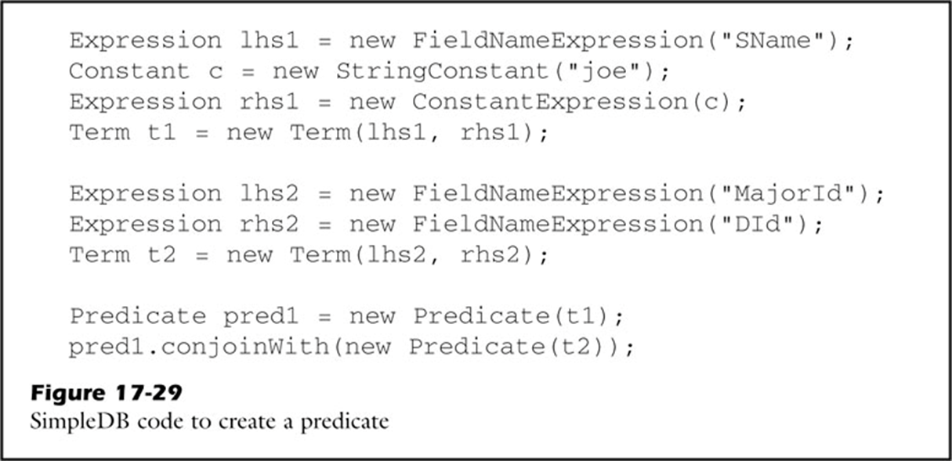
Predicates
Sname=‘joe’ and MajorId=DId

Slide 45
Q&A

